Slide 1

SPADE Manual
Ma Diming
madiming@ic.sjtu.edu.cn

Slide 2
SPADE Introduction
SPADE is short for Simulation Program for Analog Design Education
thanks to his father, Prof. Shi.
Design Features
  Schematic Editor (Cadence Virtuoso, or SED)
  Simulator (Synopsys HSPICE)
  2D/3D GUI for results representation
  Hierarchical design support
  Parameters variation consideration
  Analog design target consideration (PM, ro, A, etc.)
  Symbolic & Accurate
  Matlab like function representation
  Specified model simulation
  … …

Slide 3
Analog Design Flow
Schematic Descriptions
Circuit Descriptions
Netlist Descriptions
Numerical, HSpice, Spectrum
Simulation
Re-Design
Symbolic, GRASS
Waveforms, Curves, Avanwaves
Results & Analysis
Direct Optimal Results, W/L
No
No
Meet Requirements?
A, PM, Z-P, SNR, BW, SR, …
Yes, Design Done
Ideal: Requirements + Design Solution => Results

Slide 4
SPADE Design Flow
Circuits
SPADE Flow
Netlist
DC Sim
Model Extraction
2D/3D Representations
H(S)
Graph Reduction
GRASS Role

Slide 5
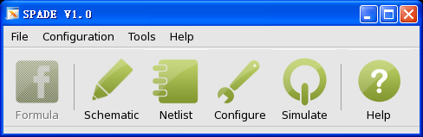
SPADE Framework
A HSpice Like Interface
SPADE
Menu
Formula
Schematic Editor
Cadence ICFB
Netlist
Configure
Simulate
Help & About
Points
Flow is like: Formula / ICFB->Netlist->Configure->Simulate
2D/3D, Parallel, etc. options decided by user to show the results

Slide 6
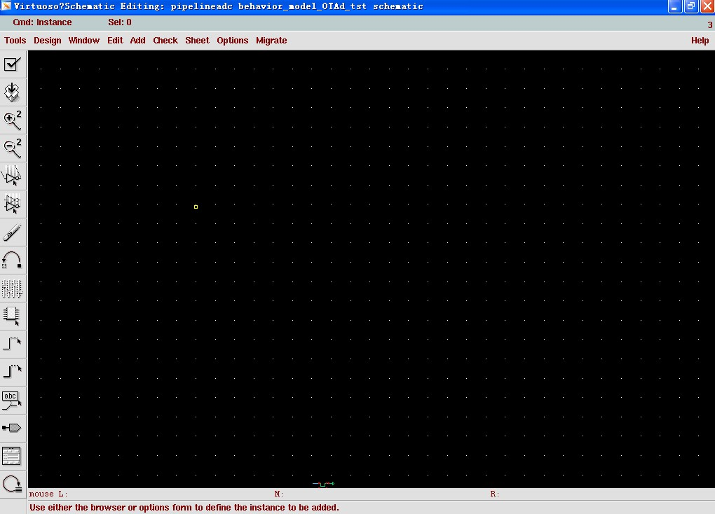
SPADE Operations
Launch Cadence ICFB

Slide 7
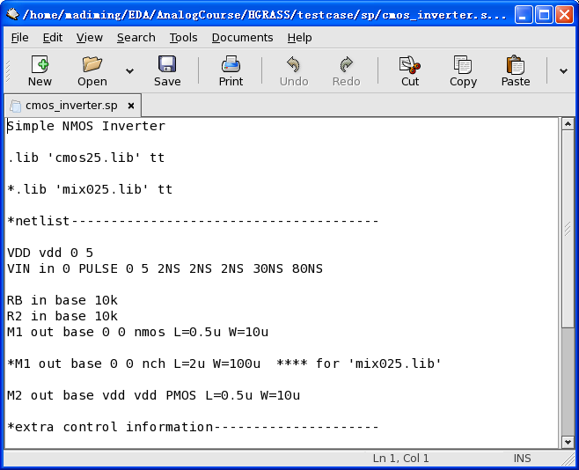
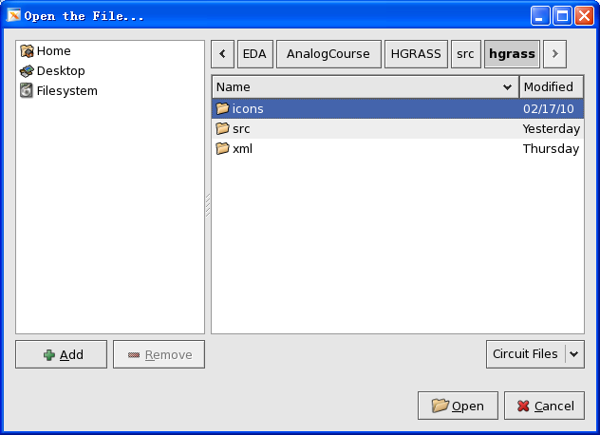
SPADE Operations
Launch GEdit for Text Operations

Slide 8
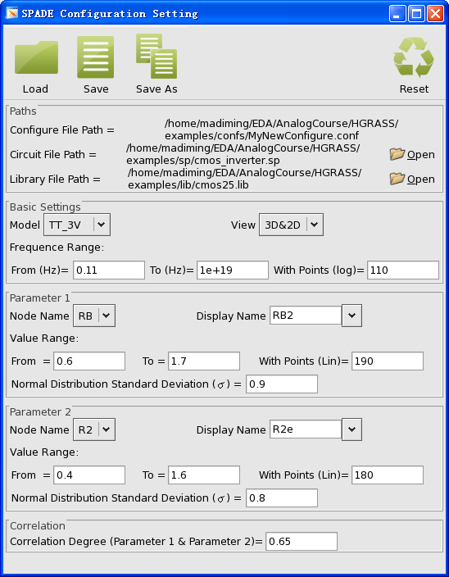
SPADE Operations
Launch GUI for Configure Options Setting

Slide 9
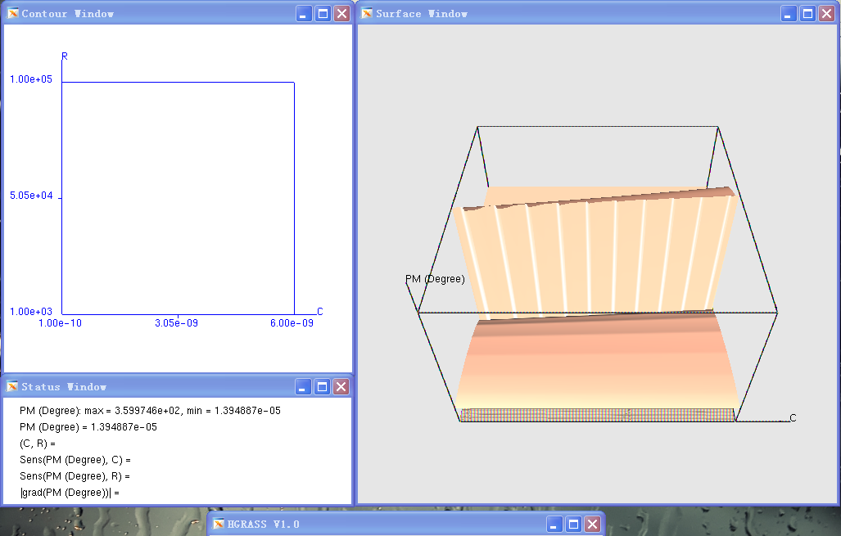
SPADE Operations
Start GRASS Based Simulation

Slide 10
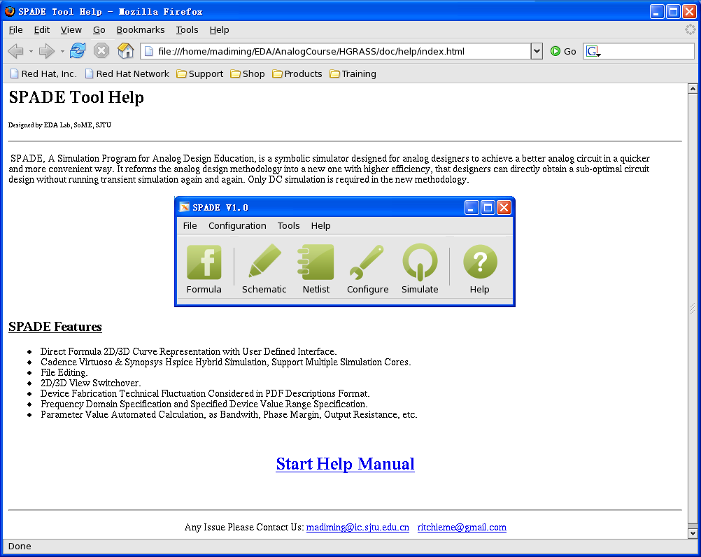
SPADE Operations
Help & About Documentation

Slide 11
Current SPADE
Current SPADE Features
  Support Cadence & Synopsys mixed tool co-work
  Support bandwidth and phase margin based design target oriented design considering parameter variations
  Support multi-dimensional result representation
  Only need DC simulation by HSPICE, no transient simulation needed
Current SPADE Defects
  Not support sub-circuit and hierarchical design
  Not support “+” mark or other complicated mark in HSPICE format
  Not support format editing and black-box model creation
  Not support other design targets except bandwidth and phase margin
  Not support large circuit, say over 23 mosfet transistors
  Not support IO definition and other kind of operations by schematic editor
  Not support bipolar
Most of the Defects will be turned into Features by your midterm project
If you ARE Interested, we can do it together, WELCOME to join to the SPADE develop project

Slide 12
SPADE Design Steps
Login to the server 192.168.5.90 for SPADE Binary
Open a new terminal and enter into the folder you downloaded the binary
Type “csh” or “source ~/.cshrc” to configure the environment variables
Make sure the files under script folder are executable or type “chmod +x script/*” command to make it executable
Make sure your time by “date” command updated with the server
Launch the SPADE tool by command “./SPADE”
Launch Cadence ICFB by clicking the “Schematic” Button
Create your own circuit by Virtuoso following your TA’s instructions
Generate the HSPICE formatted netlist
  Set the simulator as HSPICE-D
  Create the netlist and save
Launch GEdit to modify the created netlist

Slide 13
SPADE Design Steps
Modify the netlist as followings
  Add comment in the format “*IODEF: VIN [InputNode] [InputNode AC Amp] VOUT [OutputNode]” after the 1st line, eg. “*IODEF: VIN 2 1 VOUT 4”
  Add library statement, eg. “.lib ‘examples/lib/cmos25.lib' tt” at the beginning of the file
  Add simulation statement “.op” and “.options list node post=2 probe” right above the “.end” statement, statement “.print ac VDB([OutputNode]) VP([OutputNode])” is strongly suggested to be added too
  Comment “.global” statement, replace the node nonsense to make it meaningful, eg. replace “_gnet*” to “0” or “vdd” in the whole file
  Comment “.TEMP” statement and statements with “+” mark
  Make sure the following things are as required
    No mosfet named “m0” exist, otherwise rename it to a index positive
    VDD and GND node is named as “vdd” or “vdd!” and “gnd” or “0”
    NMOS and PMOS model is within the library file, say “nmos” for “cmos25.lib” and “nch3” for “log018.l”
    The simulation level is within the library file, say “tt” for “cmos25.lib” and “tt_3v” for “log018.l”
  Save the circuit file

Slide 14
SPADE Design Steps
Save the modified netlist and configure the environment variables
  The view option will decide 2D, 3D or 2D and 3D result representation by GRASS
  The library and model option currently is useless but still suggested to be set
  All the other options must be set before you go to the simulation stage
  “Node name” and “Display name” can be the same for each parameter
  Save the configure settings to a file
Run the simulation by choosing the right configure file
  If error found during the simulation stage, check the error messages or the popped error file information and do as the information indicates
Finish the 2D & 3D results analysis

Slide 15
SPADE Design Steps
2D Operations
  Parameters might be too many for you, just choose the right one
  All the buttons and menus are not responsible except the “export” one
  2D Results is currently with only Amp and PM properties
3D Operations
  3 windows popped up, surface window (Target-P1-P2), Contour Window (the crossed surface curve with the 3D distributions), Status Window (the related data value)
  You can move the 3D curve by “up”, “down”, “left” and “right”; “page up”, “page down”, “home” and “end” key of the keyboard
  Drag the surface to cross the 3D curve by your left mouse button
  Right click your mouse in the surface window to switch between different target of analog design
  Other hot key bindings, please refer to the next page

Slide 16
SPADE Design Steps
3D curve hot key bindings (Surface Window)
  “I” – reset the reference square plane
  “i” – refresh the surface window
  “G”/”g” – refresh the surface window
  “<space>” – refresh
  “<ESC>” – exit
  “l” – save current contour line as lower bound
  “L” – show lower bound info
  “u” – save current contour line as upper bound
  “U” – show upper bound info
  “a” – set previous contour line save or not
  “p” – save contour line as a phase margin copy
  “P” – save contour line as a d(phase margin)/dx copy
  “b” – save contour line as a band width copy
  “B” – save contour line as a d(band width)/dx copy

Slide 17
SPADE Design Steps
3D curve hot key bindings (Contour Window)
  “c” – switch between display all saved contour lines as constraints or not
  “C” – clear all saved contour lines
  “d” – switch between design center point display or not
  “m” – switch between auto-point absorption or not

Slide 18
SPADE Manual
Thank You
Any question, please feel free to contact me by
madiming@ic.sjtu.edu.cn

